Slide 1


NCAA Bracket Predictor Sprint 4
Nate Lang, John Hattas, Kevin Brosam, Alex Berkhout, Matt Petter

Slide 2
Sprint 4 Overview
Main Goal:
Polish Website
Produce better algorithm

Slide 3
User Story Example
John wants to use the website easily, from both his desktop and his mobile device. He wants to select multiple indicators and see what percentage of the bracket he got right for previous years. He also wants to see which picks the prediction got right and wrong. He wants to try multiple different ones and see what his high score is. When it is all said and done he wants to close out of the website with ease.

Slide 4
Tests

Slide 5

PRODUCT DEMO

Slide 6
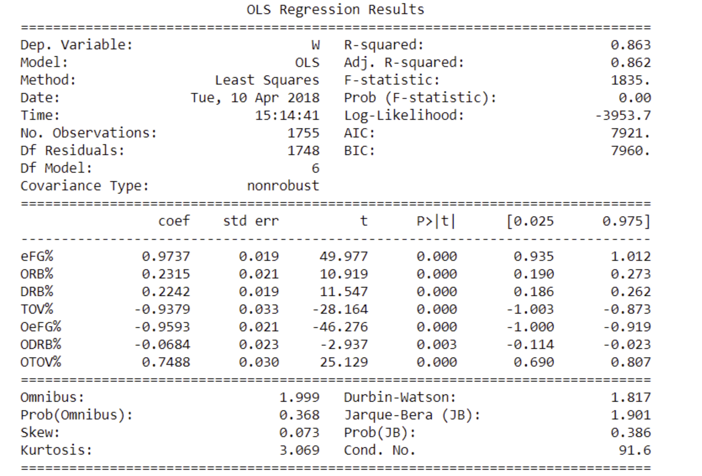
Statistical Methods

Slide 7
Backlogs
Sprint Backlog
Product Backlog
Task | Priority [1-10 (1 being lowest)] | Completed(Y/N)
Have Django code display a bracket depending on selected indicator | 6 | Y
Create graphs to give visual model | 9 | Y
Develop a statistical method for variable removal | 4 | Y
Have Django code able to select which year to use | 8 | Y
Have Django display what % of bracket is correct | 4 | N
Host website | 10 | Y
Have Django code display what possible indicators it can use | 7 | Y
Have Django code display the bracket and which teams it picked | 7 | Y
Develop a machine learning approach to find best possible bracket | 7 | N
Task | Priority [1-10 (1 being lowest)] | Completed(Y/N)
Develop an algorithm that predicts previous tournaments results | 1 | N
Integrate more advanced statistics | 7 | Y
Create picture of the bracket with appropriate teams | 7 | Y
Collect Data | 10 | Y
Have a basic working model | 10 | Y
Back test for better prediction results | 4 | N
Potentially display through HTML | 1 | Y
Update for 2018 tournament | 3 | Y
Compare different basic algorithms to find the easiest while not losing accuracy | 8 | N
Display data in charts and tables | 5 | Y
Add location as one of the indicator | 2 (if reasonably possible) | N
Create User Interface | 4 | Y

Slide 8
Sprint Retrospective

